Slide 1
Computer Hardware and Software
Contents
Tech Talk: Introducing Your Computer
Types of Computers
Hardware Basics
Computer Memory and Storage Basics

Slide 2
Introducing Your Computer
Key Terms
You Will Learn
personal computer (PC)
central processing unit (CPU)
bit
byte
hardware
input
output
random-access memory (RAM)
read-only memory (ROM)
storage device
software
operating system (OS)
How computers work
To identify hardware
How memory and storage are used
To identify software
How networks work

Slide 3
Introducing Your Computer
Types of Computers
personal computer (PC)
A computer used by one person at a time.
Computers can be grouped by size, purpose, and number of users.
Type of Computer | Number of User at One Time | Size | Typical User/Purpose
Personal computer (PC) (microcomputer) | One | Fits on a desk, on a lap, or in a hand | Used by individuals for organizing information, creating products, and entertainment
Minicomputer | Several to hundreds | Occupies part of a room | Used by small to medium-sized organizations, such as schools
Mainframe (super computer) | Thousands | Room-sized | Used by large corporations and government agencies

Slide 4
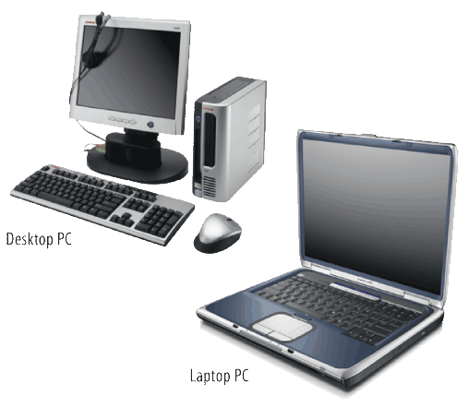
Introducing Your Computer
Types of Computers
PCs and Macs
Personal computers are grouped by the software they use:
PC - uses the Microsoft Windows operating system
Mac - uses the Macintosh operating system
Examples of personal computers are:
Desktops
Laptops
MP3 players
Mobile devices, phones, tablets, wearable devices (smart watch…)

Slide 5
Introducing Your Computer
Types of Computers
central processing unit (CPU)
A microprocessor, or tiny computer chip, that receives and carries out all the instructions given to a computer.
How Does My Computer Work?
The “brain” of a computer is the central processing unit (CPU). When the CPU receives and carries out an instruction, it has completed one cycle.
Computer’s speed = number of cycles completed in one second
Cycles are measured in:
Megahertz (MHz) = millions of cycles per second
Gigahertz (GHz) = billions of cycles per second

Slide 6
Introducing Your Computer
Types of Computers
bit
The smallest unit of computerized data
byte
The building block for all information that flows through a computer.
Bits, Bytes, and Binary Numbers
Bits and bytes are small pieces of computerized data that communicate commands to a computer’s CPU:
A bit is either a 1 or a 0 (binary digits).
A byte contains eight bits.
Each letter in the English language is represented by one byte.

Slide 7
Introducing Your Computer
Types of Computers
How Big Is a Terabyte?
Common storage units:
Kilobyte (KB) = 1,000 bytes
Megabyte (MB) = 1,000 bytes, or 1 million (1,000,000) bytes
Gigabyte (GB) = 1,000 MB, or 1 billion (1,000,000,000) bytes
Terabyte (TB) = 1,000 GB, or 1 trillion (1,000,000,000,000) bytes

Slide 8
Introducing Your Computer
Types of Computers
Compare and Contrast What are some similarities and differences between mainframe computers and personal computers?
Some similarities are:
Both have a central processing unit (CPU).
Both read only 1s and 0s.
Both recognize and process bits and bytes.
For both, speed is determined by cycles per second.
Some differences are:
Mainframes are very large. PCs can be very small.
Mainframes can be used by thousands of people at once. PCs can only be used by one person at a time.
Mainframes are used by corporations and government agencies. PCs are used by individuals, like students!

Slide 9
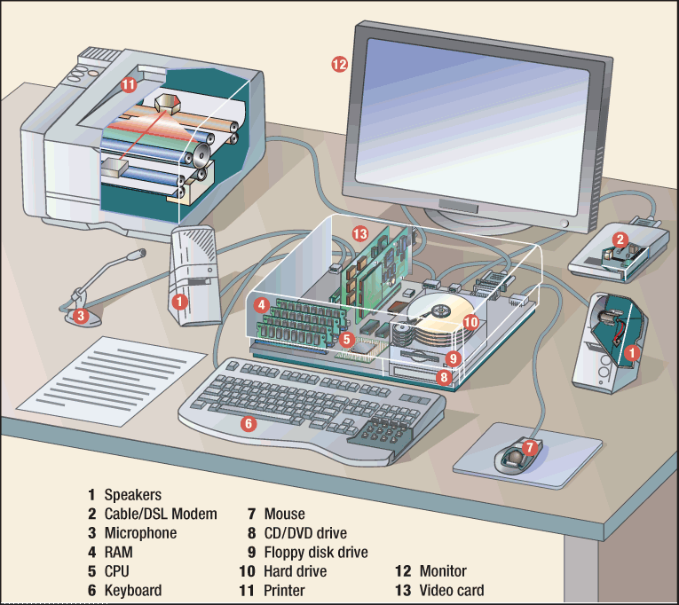
Introducing Your Computer
Hardware Basics
Your computer may use hardware like the components shown here.
hardware
The collection of physical pieces, or components, that make up a computer.

Slide 10
Introducing Your Computer
Hardware Basics
Hardware can be inside or outside the computer:
The CPU and hard drive are inside the computer.
2 Types of Hard drives – Magnetic and Solid state (SSD)
The keyboard, monitor, and printer are outside the computer and must be connected by cables.

Slide 11
Introducing Your Computer
Hardware Basics
input
Information that is entered into a computer.
output
Information that a computer produces and delivers back to the user.
What Are Input and Output Devices?
Information flows between you and your computer through input and output devices. Examples of input devices are:
keyboard
mouse
scanner
digital camera
joystick
Examples of output devices are:
monitor
printer
speakers

Slide 12
Introducing Your Computer
Hardware Basics
Identify Name three hardware components that are also input devices, and three hardware components that are also output devices. (Try to think of input and output devices that have not been mentioned yet.)
Input devices include:
digital camera
joystick
keyboard
microphone
mouse
scanner
touch screen
trackball
Output devices include:
monitor
printer
projector
speakers

Slide 13
Introducing Your Computer
Computer Memory and Storage Basics
read-only memory (ROM)
Memory that permanently stores data and that cannot be erased or changed.
random-access memory (RAM)
Temporary memory that a computer uses to store data and process information while working in a program. It is erased when the computer is turned off.
When Do I Use RAM and ROM?
When you use your computer to perform any type of task, you are using two types of memory:
Type of Memory | What Does It Do? | When Is It Used?
Read-only memory (ROM) | Stores permanent information like telling the computer how to start up | When you turn a computer on or off
Random-access memory (RAM) | Stores temporary information when you are working in a file | When you start and use software

Slide 14
Introducing Your Computer
Computer Memory and Storage Basics
storage device
Computer equipment used to store data. Examples of storage devices are hard drive, network server, floppy disk, CD, DVD, and USB flash drive.
2-Types of Hard Drives
Magnetic and SSD – Solid State Hard Drive
How Is Information Stored?
When you save a file, you move the information from RAM to a storage device. The type of storage device depends on how much space is needed. Music and video files require more storage space than text files.

Slide 15
Introducing Your Computer
Hardware Basics
Explain What do ROM and RAM stand for, and what do they do?
ROM:
Stands for read-only memory
Is permanent memory
Works when you turn a computer on or off
Stores data even when a computer is turned off
RAM:
Stands for random-access memory
Is temporary memory
Works when you start and use software
Stores data only while a computer is on

Slide 16
Introducing Your Computer
Software Basics
software
A set of instructions, also called a program or application, that tells a computer how to perform tasks.
operating system (OS)
Software that controls all the other software programs and allows a computer to perform basic tasks.
Software is the set of instructions that lets you “talk” to your computer. Software translates commands into bits and bytes. Different types of software have different functions:
Operating system (OS) software - makes your computer work
Application software - lets you do different tasks on your computer
Utility software - helps you maintain your computer and keep it in good running condition

Slide 17
Introducing Your Computer
Software Basics
What Is an Operating System?
The operating system (OS) controls all other software and allows the hardware devices to work properly. Some popular operating systems are:
Microsoft Windows - for PCs
Mac OS - for Apple computers
Linux - for very large network computers
Handheld operating systems - for PDAs, MP3 players, and cell phones
What Is a GUI?
Nearly all modern operating systems use a graphical user interface (GUI). This lets users click on images or text on the screen instead of having to type commands. Example Windows or Mac OS (Point and Click) Windows Environment

Slide 18
END

